Slide 1

Boston Blue Bike Analysis
CRN: 70633
ALY 6110 Big Data and Data Management
Group Beta:
Tanisha Srivastava - srivastava.tan@northeastern.edu
Jacob Vandergriff - vandergriff.j@northeastern.edu
Abhinav Jain- jain.abhin@northeastern.edu
Hang Wu - wu.hang@northeastern.edu
Jie Deng - deng.jie1@northeastern.edu

Slide 2
Summary
Established in June 2011 in Boston
Pickup Bike (from dock station)– Ride (Specific time) – return the bike (available dock station in the city)
Share Bikes with minimal cost based on trip duration
Blue Bike provide single trip plan and monthly subscription based bike sharing platform
Tools used in handling big data
Business question in the following slide will be answered
Data Preprocessing
Comments and Technical Difficulties
Monthly data including route are shared in AWS S3 storage
Data collection and combination done by the team to compute basic EDA and graphical analysis
Conclusion and Recommendations

Slide 3
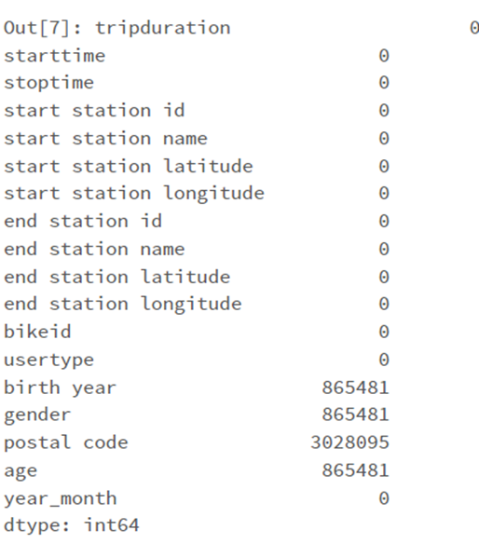
Data Introduction
Blue Bike data is from an AWS S3 Instance
Trip data ranges from Jan 2019 to Sept 2022
There are 9,836,332 trips/rows

Slide 4







Tools to Handle Big Data
We used Databricks with Spark, Python, and SQL for the data analysis
Graphframes

Slide 5
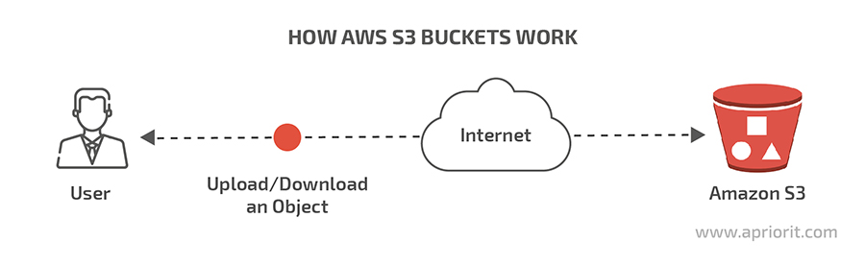
Data Handling
Difficult to handle 9 million rows
Upload the data on AWS S3
Generate the API to pull the data from S3

Slide 6
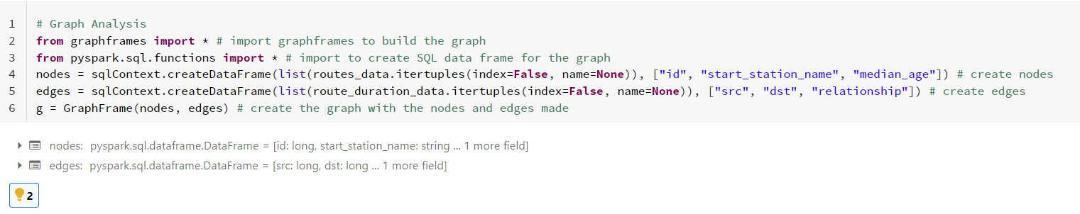
Data Preprocessing (Cleaning, Split variable, Outliers)
Missing values are focused in birth year, gender, and postal code
Missing values are not dropped in the analysis due to their use in helping understand the users
Cleanup the date to adjust month and year
Keep the outlier to understand the data through visualization.
Used GraphFrame for data visualization.

Slide 7
Business Questions
What age groups are using the Blue Bike Service?
How are stations distributed in the city?
Are there stations that are anomalous given their connections?
What are the most connected stations?

Slide 8
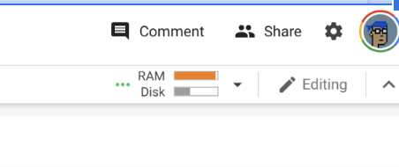
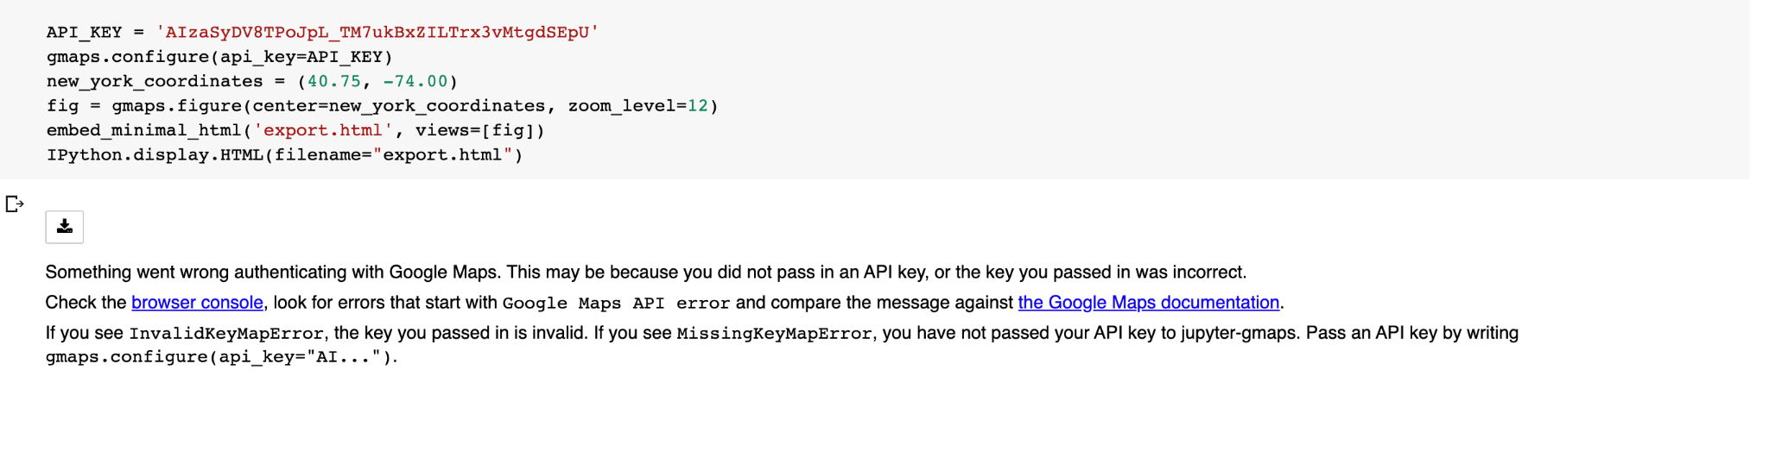
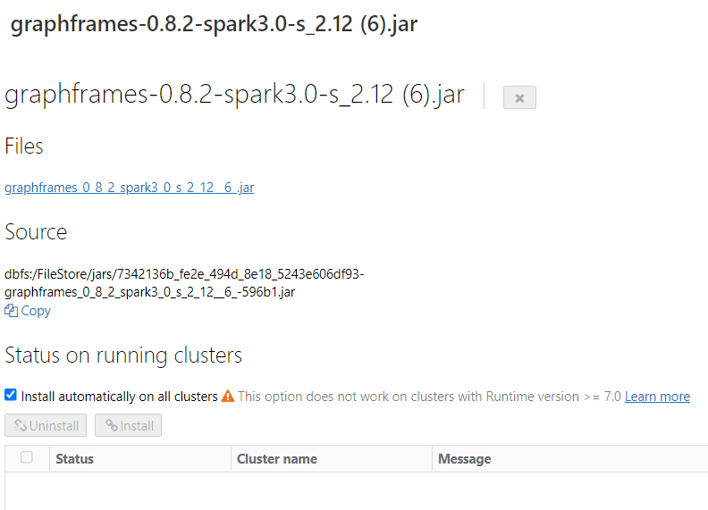
Comments and Technical Difficulties
RAM issues and computational errors for the graphic algorithm can be seen on the right
Jar importation needed
Notes:
Jar importation is there to solve the urgent issues of not having the graph frames library in the databrick community edition. We see ram issues occurred on the right. That’s ram exceeding limits, leakage..

Slide 9
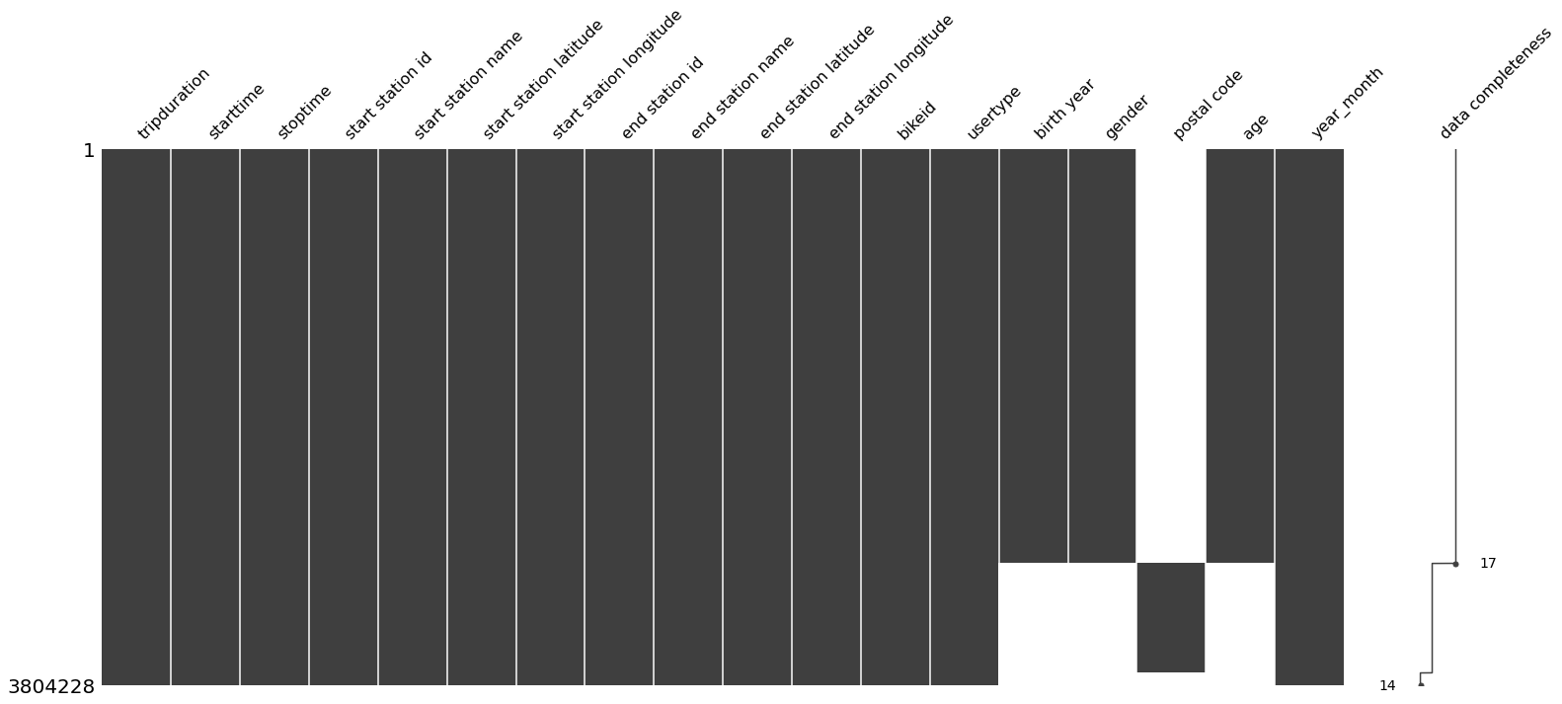
Statistical Analysis: Missing fields in the dataset
Missing data in the demographic area (gender and birth year)
They might affect the EDA later as they

Slide 10
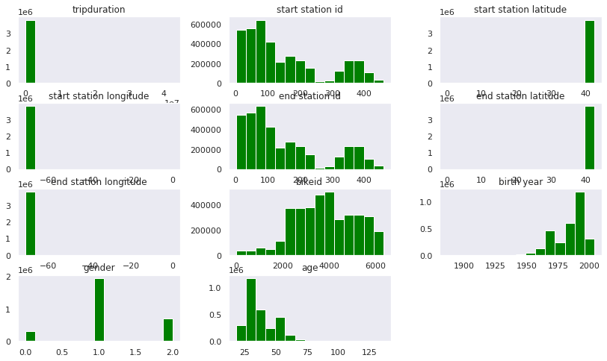
Distribution
Despite great range, most attributes are severely left skewed
Heavy tails can be spotted
Notes:
Regular statistical analysis will treat every skewed data differently, as Gsaussian distribution is often desired
This explains why we use graphic algorithm in later session.

Slide 11
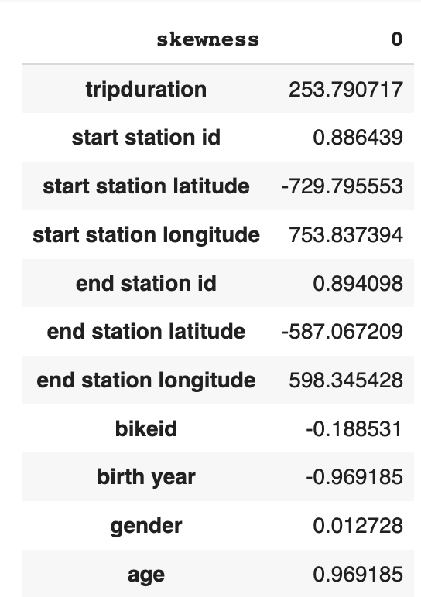
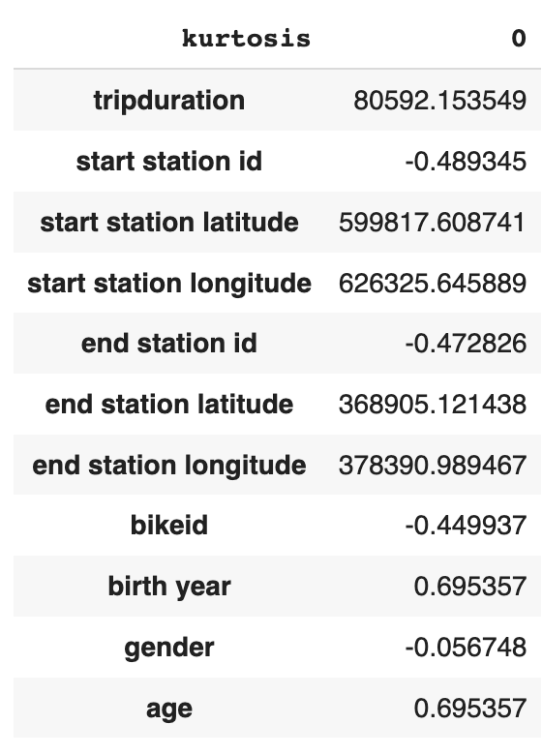
Statistical Analysis
Huge kurtosis (trip duration) suggests lots of outliers existed
Affect statistical significance of the data

Slide 12
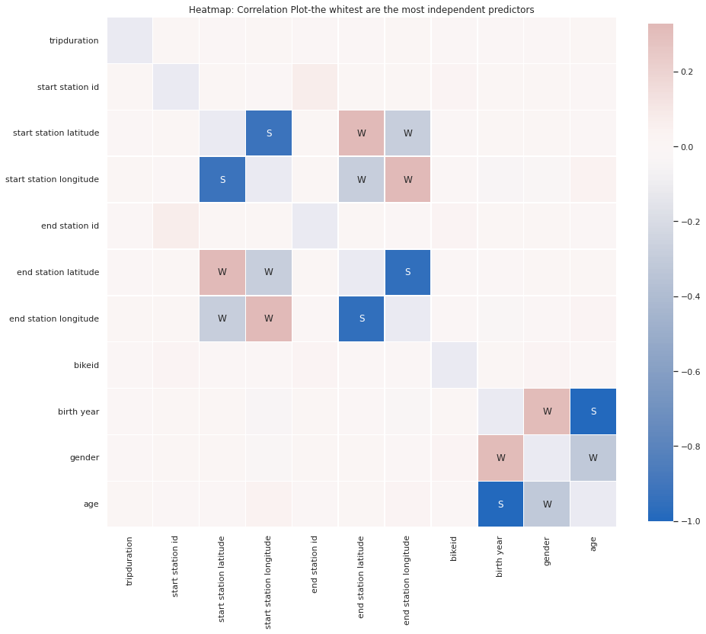
Correlation of all attributes
Coordinates shows strong linear relatability/correlation.

Slide 13
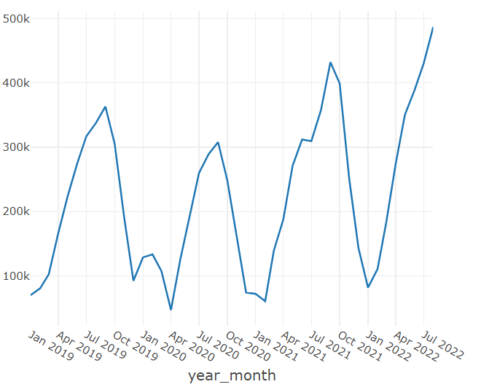
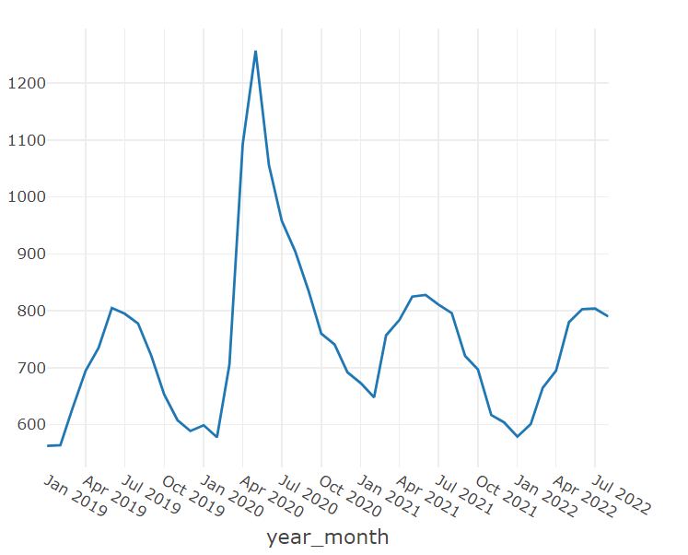
Exploratory Data Analysis - Trends
Number of Trips Over Time
Median Trip Duration Over Time
Notes:
EDA trip

Slide 14
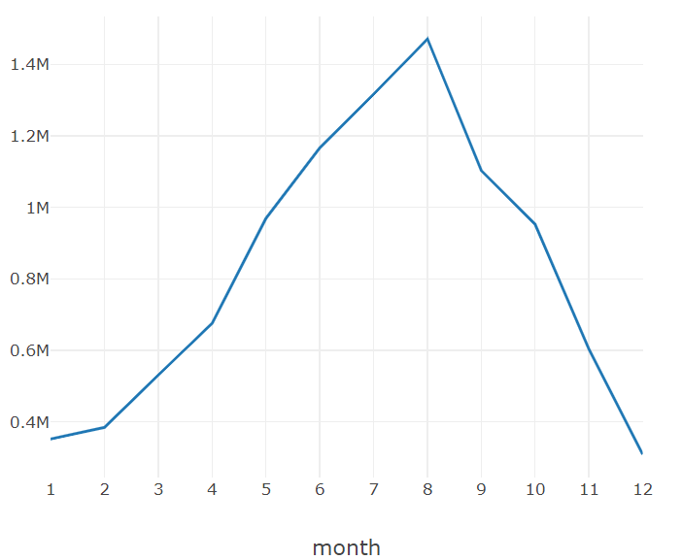
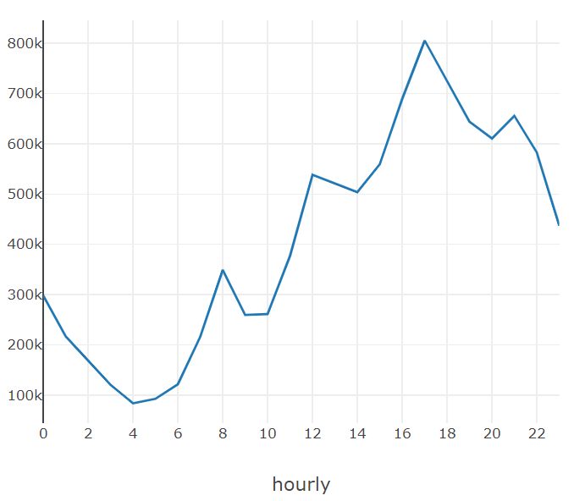
Exploratory Data Analysis - Seasonality
Monthly Seasonality - Number of Trips
Hourly Seasonality - Number of Trips

Slide 15
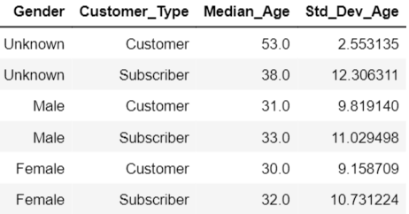
Exploratory Data Analysis - Customers
Age is more variable for Subscribers than Customers for users with a reported gender
Users with an unreported gender tend to be older
Typical age is early 30’s for bikers

Slide 16
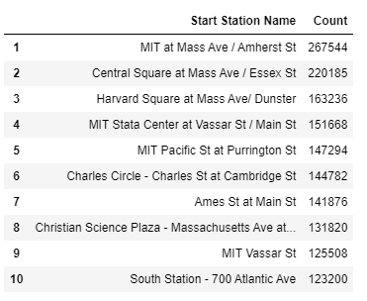
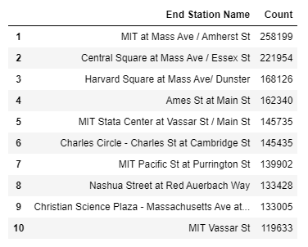
Exploratory Data Analysis - Stations
Top ten starting station
Top ten ending station

Slide 17
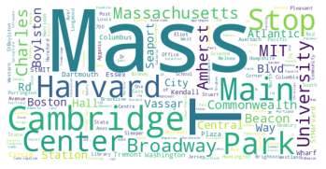
Exploratory Data Analysis - Stations
Station name Word Cloud

Slide 18
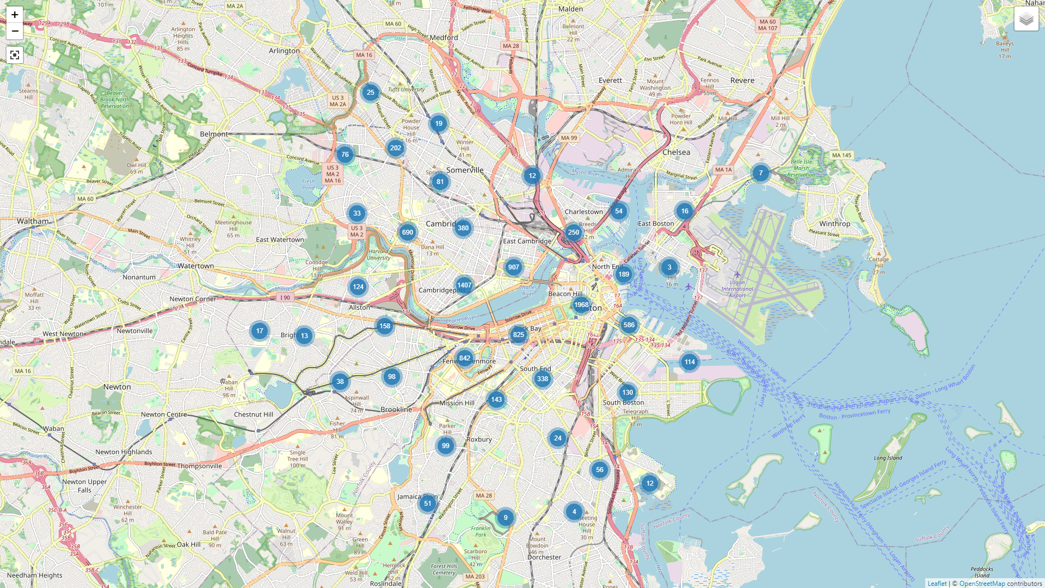
Exploratory Data Analysis - Stations
Stations are uniformly spread throughout the city
A different approach is needed to find clusters
showing first 10,000 rows.

Slide 19
Graph Analysis
Blue Bike trips create a network for which graphs are optimal
The Spark GraphFrames API is used to create an undirected graph
Label Propagation is used to find communities or unique nodes in the graph

Slide 20
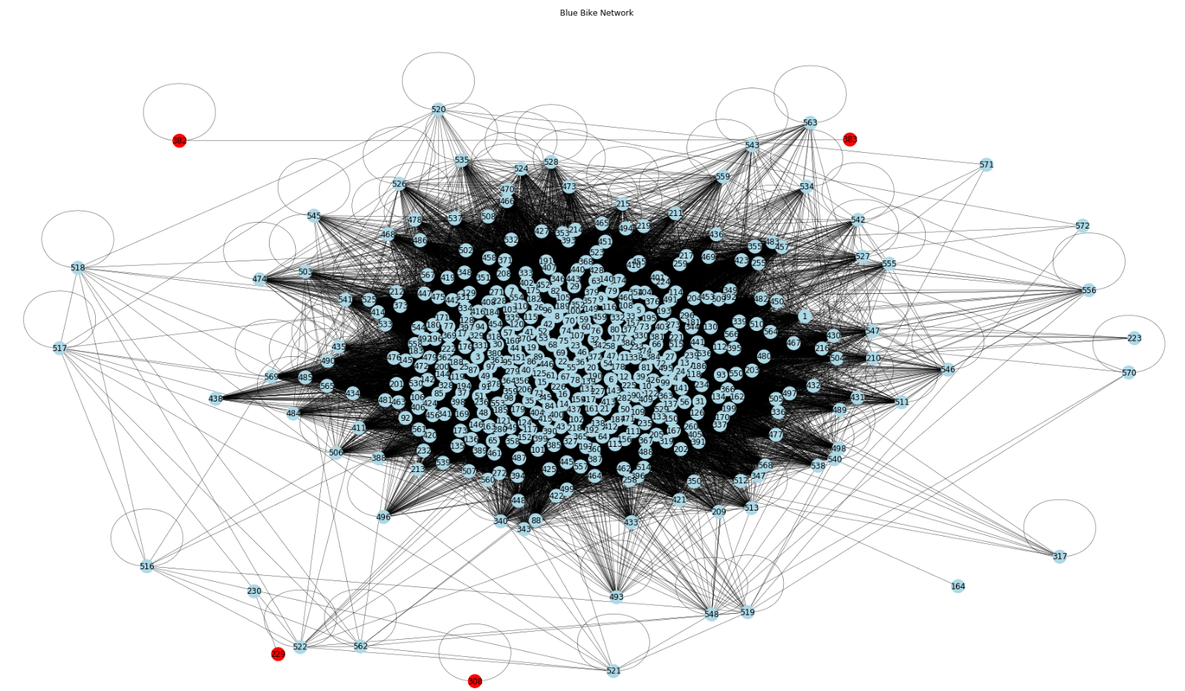

Slide 21
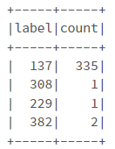
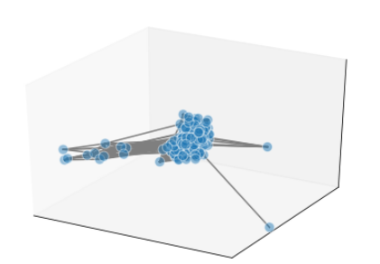
Findings of Label Propagation
Four communities:
Unique stations are clustered based on their lack of use or the station no longer exists
3D Model of BB Network

Slide 22
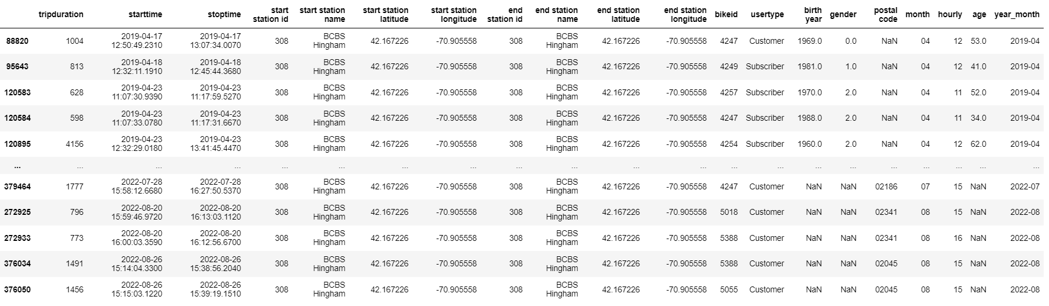
Unique Stations Analysis
Station 308

Slide 23
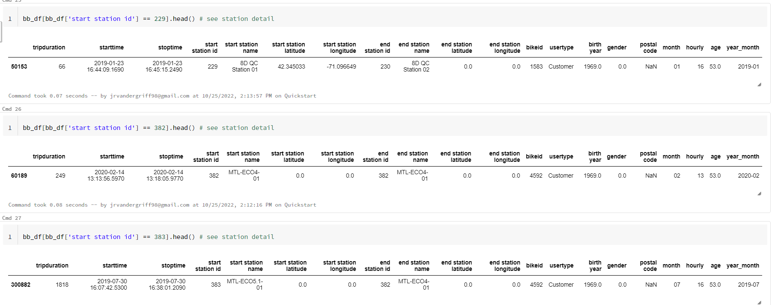
Unique Stations Analysis
Stations 229, 382, 383

Slide 24
Conclusion
Using Databricks, we were able to process a ~9 million row data set.
Most technical difficulties revolved around library importation and the computation environment
Graph analytics and basic EDA were able to answer our business questions:
What age groups are using the Blue Bike Service?
Younger adults in early 30s
How are stations distributed in the city?
Stations are uniformly distributed
Are there stations that gave be considered anomalous given their connections?
Stations that have bad data quality or are somemly used are considered anomalous
What are the most connected stations?
Stations in on Mass Ave are the most connected stations

Slide 25
Thank you and Contact Information
Tanisha Srivastava - srivastava.tan@northeastern.edu
Jacob Vandergriff - vandergriff.j@northeastern.edu
Abhinav Jain- jain.abhin@northeastern.edu
Hang Wu - wu.hang@northeastern.edu
Jie Deng - deng.jie1@northeastern.edu

Slide 26


Slide 27
References
Chen, D. (2021, July 15). Label propagation algorithm and its Application. Medium. Retrieved October 20, 2022, from https://medium.com/@dezhouc2/label-propagation-algorithm-and-its-application-162d03f10d3a
Graphframes - Spark Packages. (n.d.). Retrieved October 20, 2022, from https://spark-packages.org/package/graphframes/graphframes
Motivate International, I. (n.d.). Bluebikes System Data. Blue Bikes Boston. Retrieved October 20, 2022, from https://www.bluebikes.com/system-data
OpenKB. (1970, January 1). Understanding PageRank algorithm in Scala on spark. Open Knowledge Base. Retrieved October 20, 2022, from http://www.openkb.info/2016/03/understanding-pagerank-algorithm-in.html
Software for complex networks#. Software for Complex Networks - NetworkX 3.0b2.dev0 documentation. (n.d.). Retrieved October 20, 2022, from https://networkx.org/documentation/latest/index.html
Spark SQL, DataFrames and datasets guide. Spark SQL and DataFrames - Spark 2.3.1 Documentation. (n.d.). Retrieved October 20, 2022, from https://spark.apache.org/docs/2.3.1/sql-programming-guide.html
Visualizations. Visualizations | Databricks on AWS. (n.d.). Retrieved October 20, 2022, from https://docs.databricks.com/notebooks/visualizations/index.html

